Slide 1
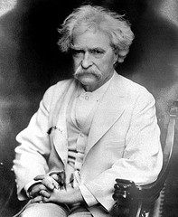
The Gilded Age: 1877-1900
Analyze the quote below. How does Twain’s quote reflect the attitudes of many Americans during the late 1800s?
Mark Twain
“What is the chief end of man? - to get rich. Dishonestly if we can; honestly if we must.”
Mark Twain

Slide 2
Gilded Age Ideas
By calling this era the Gilded Age, Twain was commenting on what he saw as a corrupt society.
A gilded age might appear great, but critics pointed to corruption, poverty, crime, and great disparities in wealth between the rich and the poor.

Slide 3
Chapter 4 Lesson 4 – Political Challenges of the Gilded Age
In the late 1800s, the two major political parties were very competitive. People argued over issues such as tariffs and business regulations. Farmers faced falling crop prices and deflation. These farmers tried to solve their problems by forming organizations. In the 1890s, many farmers joined the Populist Party.

Slide 4
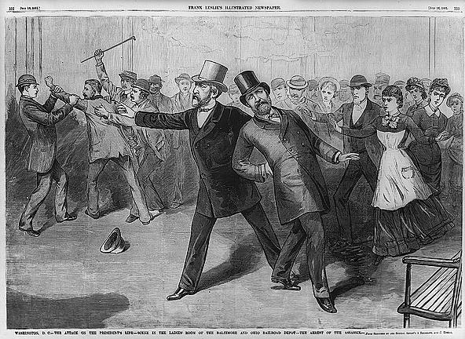
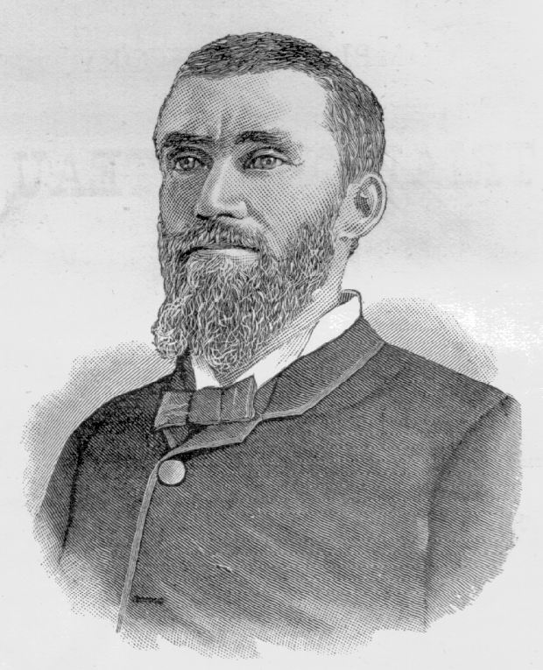
1881: Garfield Assassinated!
Charles Guiteau: I Am a Stalwart, and Arthur is President now!

Slide 5
Balance of Power Creates Stalemate
Only twice between 1877 and 1897 did either the Republicans or Democrats gain control of the White House and both houses of Congress at the same time.
In comparison to Lincoln, the Presidents of the Gilded Age appeared particularly weak. They won by slim margins and seemed to lack integrity.
Rutherford B. Hayes: Owed his Presidency in 1877 to a secret deal.
Benjamin Harrison: 2nd president in history to lose the popular vote but win the electoral college vote.
Chester Arthur: Replaced James Garfield after his assassination. Failed to win his own party’s presidential (Republican) nomination in 1884.
Grover Cleveland: In an era known for corruption, he maintained a reputation for integrity.

Slide 6
Civil Service Reform
Spoils System Dominates Politics
Spoils System: Politicians awarded government jobs to loyal party workers, with little regard for their qualifications.
Aka – PATRONAGE
1865 = 53,000 people worked for the Federal Government
1890 = 166,000 people worked for Fed. Gov’t
Civil Service: Government departments and their nonelected employees.
Civil Service Reform Promotes Honest Government
Many attempts by Gilded Age presidents to reform
Civil Service Reform: Garfield’s assassination convinced the public that the spoils system was corrupt. The Pendleton Act was passed in 1883, requiring competitive exams for some jobs. This began professional civil service.
Pendleton Civil Service Act: Law that created civil service system for the federal government in an attempt to hire employees on a merit system rather than on a spoils system.

Slide 7
Regulating Commerce
Commerce
Corporations became incredibly powerful because neither party believed the government should interfere with corporate power.
When states passed laws regulating railroad rates, the Supreme Court ruled the regulations unconstitutional.
The Interstate Commerce Act passed in 1887 created the Interstate Commerce Commission (ICC), which proved nearly powerless without judicial support.

Slide 8
Regulating Commerce
Antitrust Laws
Political Pressure:
Congress responded to popular pressure to combat trusts by passing the Sherman Antitrust Act in 1890.
Weakened by judicial interpretation, vague wording, and poor enforcement, the law had little impact.

Slide 9
Farmers Face Many Problems
What major problems did farmers face during the Gilded Age?
Received low prices for their crop (1870-1895).
Paid high costs for transportation of crops. (Railroads)
Debts mounted while their influence on the political system declined.
To pay for basic operation supplies farmers went into debt.
Farmers mortgaged their farms to raise funds to survive and became tenant farmers—they no longer owned the farm they worked.
Railroads and banks charged what ever rates they wanted.
Sharecroppers had to deal with dishonest merchants and landlords. (Blacks: High Costs/Low Pay)

Slide 10
Farmers Organize and Seek Change
The Grange – “Patrons of Husbandry”
Farmers union founded by Oliver Hudson Kelley
Promoted:
Education on farming techniques
Regulation of railroad rates (and grain storage fees)
Prompted the federal government to establish the ICC
Farmers’ Alliances
As the Grange faded away in late 1870s, farmers in the South (“Southern Alliance”) and the Midwest (“Northern Alliance”) formed cooperatives to help each other
Farmers’ Alliances were more political than the Grange (more social)
Colored Farmers’ Alliance shared the same goals as other alliances

Slide 11
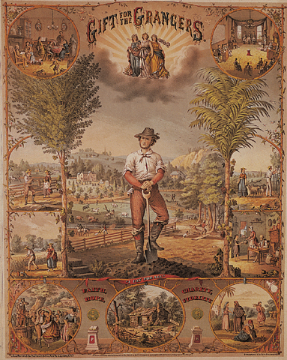
Grangers – “The Farmer Pays for All”

Slide 12
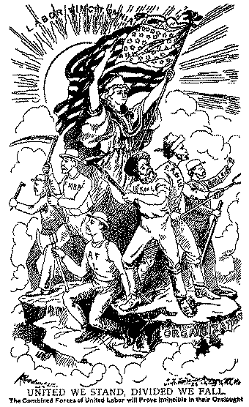
Farmers’ Alliances

Slide 13
Populist Party Demands Reforms
Populist Party Demands Reforms
The Populist Party = the Party of the People
POPULISM PLATFORM
Sought to build a new political party from the grass roots up.
Called for the coinage of silver, or “free silver”.
Demanded government ownership of railroads, and telegraph companies
Direct election of senators
1 year term for pres./V.P.
Early success = Elected three governors, five senators, and ten congressmen.
Economic Crisis
4 year Economic Depression started in 1893 – major corporations went bankrupt; 16,000 businesses failed; 500 banks closed; unemployment = 3 million by 1895
Farmers suffered BIG LOSSES

Slide 14
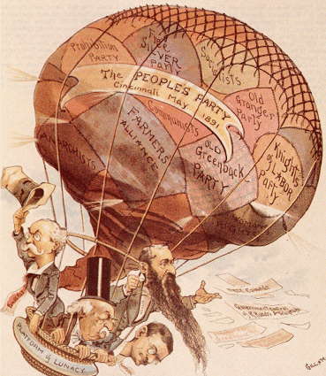
Populist Party

Slide 15
Decline of Populism
The decision of the Democratic Party to nominate William Jennings Bryan as their presidential candidate put the election for the Populists on an entirely different plane, leading some to believe they could win the White House that year.
William Jennings Bryan was the first presidential candidate to tour the nation and talk directly to the people.
Gave the “Cross of Gold Speech” (in favor of silver coinage)
William McKinley beat Bryan in the election of 1896 and 1900.
Bryan’s emphasis on monetary reform, especially free silver, did not appeal to urban workers, and the Populist Party failed to win a state outside of the South and West.
Most followers of the Populist Party returned to the Democratic Party in 1896.

Slide 16
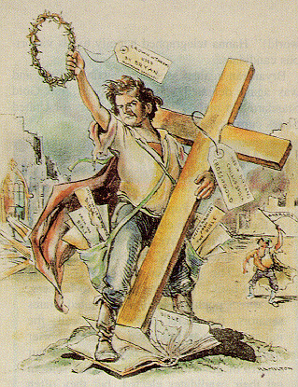
“Cross of Gold Speech”
You shall not press down upon the brow of labor this crown of thorns; you shall not crucify mankind upon a cross of gold!

Slide 17
Legacy of Populism
Progressive era of early 1900s
Reforms enacted (brought to light by populists)
Gradual income tax
Regulation of railroads
More flexible monetary policy
Direct election of senators

