Slide 1
Objectives – Lessons 3
Students will identify ways in which the U.S. government attempted to force Native Americans off their land.
Students will analyze and understand why the U.S. government wanted the land of the Native Americans.
Students will attempt to justify reasons why the U.S. government might have believed they had a right to the land.

Slide 2
Lesson 3
Westward Expansion & The American Indians
Main Idea:
**During the 1830’s the federal government forced Native Americans from the East to resettle west of the Mississippi River and promised them land there forever.
As whites moved West for land & gold, they came into conflict with Native Americans in the West.
From 1860-1890, a series of massacres & armed conflicts occurred between various tribes & the U.S. government over the right to land.
Question: What methods did the U.S. government use to get land from Indians in the West?

Slide 3
Cultures Under Pressure
Diverse Cultures
Pacific Northwest: Lived off of fish and forest animals. (Klamaths, Chinooks, Shastas)
New Mexico/Arizona: Irrigated land to grow corn, beans, and squash and lived in Adobe homes. (Pueblos, Navajos)
Plains Indians: Expert horsemen and hunters who lived off of the roaming buffalo and other game. (Sioux, Blackfeet, Crows, Cheyenne, Comanche)
They used all parts of the Buffalo: hide for clothing, bones for tools/weapons, heart for rituals
All Indians saw themselves as part of nature and viewed nature as sacred.
Disagreed with the white man about land ownership – didn’t believe that land could be “owned” by any one man

Slide 4
Native Americans

Slide 5
The Great Plains

Slide 7
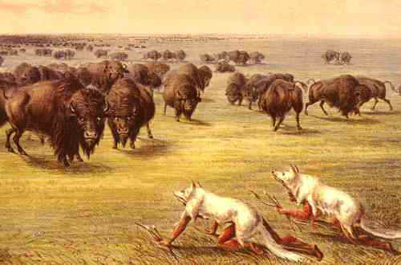
Plains Indians
Lived on the Great Plains
Lives changed with the introduction of the HORSE by the Spanish
Improved mobility – could travel farther to hunt buffalo (deer & antelope)
Buffalo (American Bison)= most important animal to plains Indians

Slide 8
Plains Indians

Slide 9
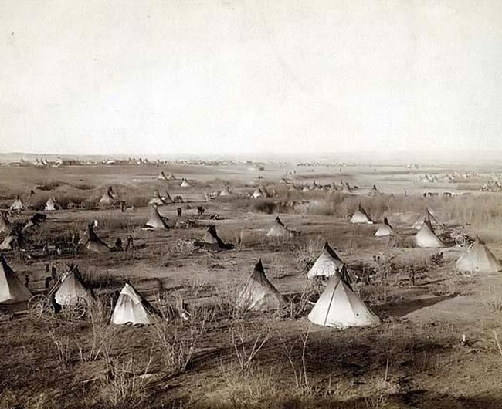
Plains Indians
Sioux

Slide 10
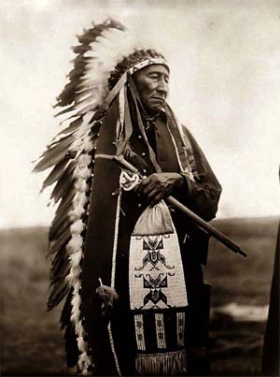
Plains Indians
Sioux

Slide 11
New Settlers & Natives Clash
White Settlers wanted to move west
1)Gold & silver was discovered in the Black Hills of the Dakotas (Sioux territory)
2) Americans wanted to build a Transcontinental railroad – had to build in Indian Territory
3) “Rain Followed the Plow”: A belief that if people farmed in arid areas, the rains would come. Farmers moved west.
MANIFEST DESTINY!!!
(Horace Greeley – p. 162)

Slide 12
New Settlers and Natives Clash
U.S. Government Changes Policies Toward Natives
Beginning in the 1850s, the U.S. government began to force Indian tribes onto Reservations – to free up land for “American” settlers
Reservations were located on the worst land possible – could no longer roam freely on the plains, and hunt. Led to poverty & suppression.
Government desired to protect and promote the idea of MANIFEST DESTINY!!!

Slide 13
Western Indian Wars

Slide 14
The Indian Wars
Massacre at Sand Creek (1864)
U.S. troops massacre 150+ Cheyenne on Sand Creek reservation
Increased violence between US & Indians
Treaty of Fort Laramie (1868)
US government agreed to not build road through Sioux territory; Abandon 3 forts
Forced Sioux off of hunting grounds, and onto reservations
Sioux had to depend on Indian Agency for land, food, and supplies
Little Big Horn (1876)
Sioux wanted to drive out settlers/Army in Black Hills of Dakotas & Montana
Sitting Bull & Crazy Horse led 2000 warriors against Colonel George Custer
All of Custer’s men were killed (250)
Battle of Wounded Knee (1890)
Followed the death of Sitting Bull
Sioux people on way to live on reservation
slaughter of over 300 Sioux;
brings end to the Indian Wars
CONFLICTS arise between Native Americans and settlers
Other key events/people/milestones
Treaty of Medicine Lodge
Red River War
Chief Joseph
Ghost Dance

Slide 15
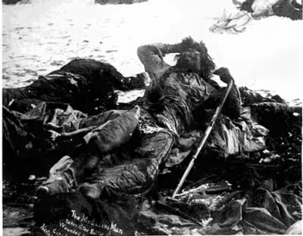
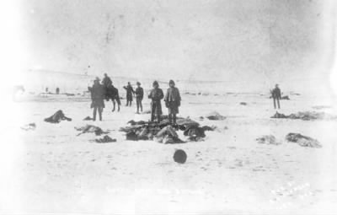
Wounded Knee

Slide 16
The Government Promotes Assimilation
Assimilation: Indians would become farmers and start to adopt the culture and civilization of whites.
1) Take land
2) Kill Buffal0
3) Force assimilation through
a) Education – change culture
b) Dawes act – make them farmers
Buffalo culture of the Great Plains is lost
Buffalo population declines
1800 = 65 million buffalo roaming the Great Plains
1890 = under 1000 buffalo left
Dawes (General Allotment) Act: Replaced the reservation system. Each Indian family was granted a 160-acre farmstead. The size of the farm was based on the eastern experience of how much land was needed to support a family.
Arid West, land not big enough.
Could not be sold or transferred for 25 years.
Boarding schools for kids.
How did U.S. force assimilation on Native Americans?

Slide 17
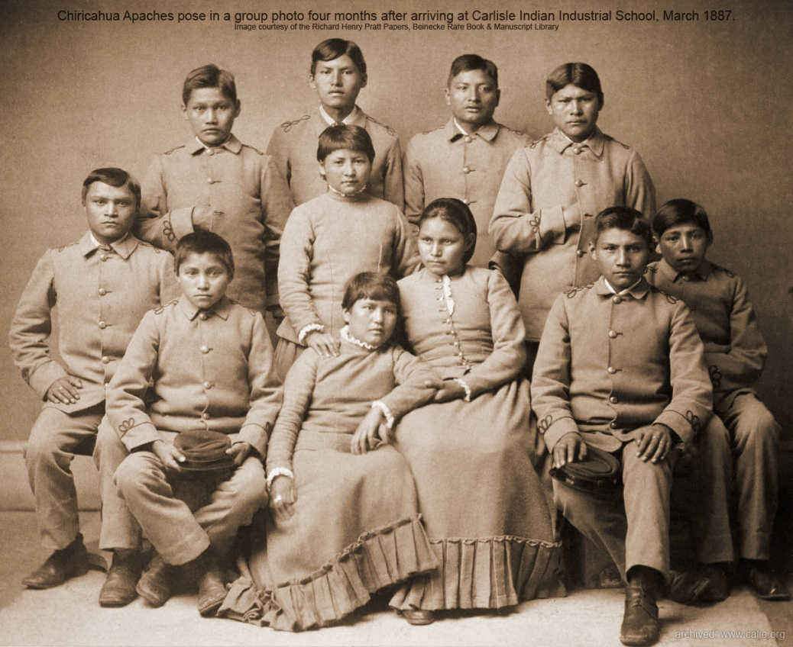
Assimilation
Apache Children BEFORE
AFTER attending white school

Slide 18
Killing of Buffalo

Slide 19
Killing Of Buffalo

Slide 20
Killing of Buffalo

Slide 21
Killing of Buffalo

Slide 22
Dawes Act

Slide 23
Dawes Act

Slide 24
Dawes Act

Slide 25
End of the Indian Wars
The belief of MANIFEST DESTINY was protected against “savage Indians”
By 1890, conflict between the U.S. government & Native Americans was over.
Native Americans’ freedom and spirit had been taken away – they were forced to live within the rules of the U.S.

Slide 26
Reservations

Slide 27
Reservations

Slide 28
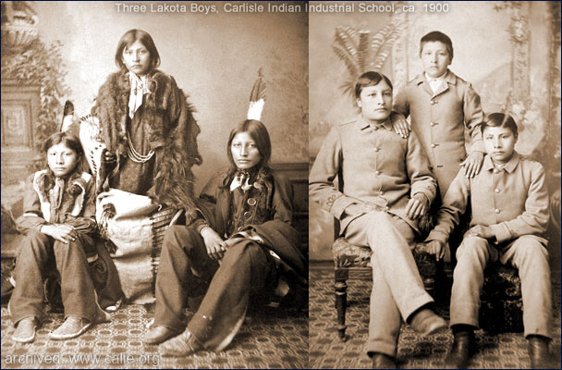
ASSIMILATION
Compare and contrast the photographs.

Slide 29
Assimilation
During the late 1800s, Captain Richard Pratt founded the Carlisle School for Indians. His ideas for reforming Native Americans can best be described in his quote:
“Kill the Indian, Save the Man”
Explain this idea. In what ways did the U.S. government attempt to carry out this idea? (paragraph in your notes)

